Slide 1
The Kinetic Theory of Gases

Slide 2
Ideal Gas Assumptions
The number of molecules in the gas is large, and the average separation between the molecules is large compared with their dimensions.
  The molecules occupy a negligible volume within the container.
  This is consistent with the macroscopic model where we modeled the molecules as particles.
The molecules obey Newton’s laws of motion, but as a whole they move randomly.
  Any molecule can move in any direction with any speed.
The molecules interact only by short-range forces during elastic collisions.
  This is consistent with the macroscopic model, in which the molecules exert no long-range forces on each other.

Slide 3
Ideal Gas Assumptions, cont.
The molecules make elastic collisions with the walls.
  These collisions lead to the macroscopic pressure on the walls of the container.
The gas under consideration is a pure substance.
  All molecules are identical.

Slide 4
Ideal Gas Notes
An ideal gas is often pictured as consisting of single atoms
However, the behavior of molecular gases approximate that of ideal gases quite well.
  At low pressures
  Molecular rotations and vibrations have no effect, on average, on the motions considered.

Slide 5
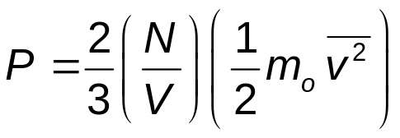
Pressure and Kinetic Energy
Analysis of the collision gives an expression for the total pressure exerted on the wall of the container .
  The pressure is related to the kinetic energy.
The relationship is
This tells us that pressure:
  Is proportional to the number of molecules per unit volume (N/V)
  To the average translational kinetic energy of the molecules

Slide 6
Pressure and Kinetic Energy
This equation also relates the macroscopic quantity of pressure with a microscopic quantity of the average value of the square of the molecular speed.
One way to increase the pressure is to increase the number of molecules per unit volume.
The pressure can also be raised by increasing the speed (kinetic energy) of the molecules.
  This can be accomplished by raising the temperature of the gas.

Slide 7
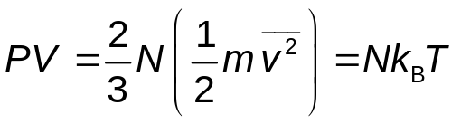
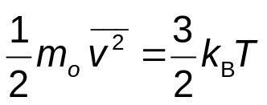
Molecular Interpretation of Temperature
We can take the pressure as it relates to the kinetic energy and compare it to the pressure from the equation of state for an ideal gas.
Therefore, the temperature is a direct measure of the average molecular kinetic. energy
Simplifying the equation relating temperature and kinetic energy gives

Slide 8
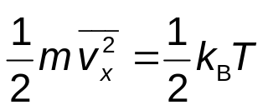
Molecular Interpretation of Temperature, cont.
This can be applied to each direction,
  Similar expressions for v_{y} and v_{z} can be found.
Each translational degree of freedom contributes an equal amount to the energy of the gas, ½ k_{B} T.
  In general, a degree of freedom refers to an independent means by which a molecule can possess energy.
A generalization of this result is called the theorem of equipartition of energy.

Slide 9
Theorem of Equipartition of Energy
Each degree of freedom contributes ½k_{B}T to the energy of a system, where possible degrees of freedom are those associated with translation, rotation and vibration of molecules.

Slide 10
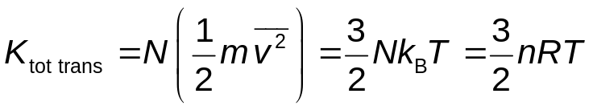
Total Kinetic Energy
The total kinetic energy is just N times the kinetic energy of each molecule.
If we have a gas with only translational energy, this is the internal energy of the gas.
This tells us that the internal energy of an ideal gas depends only on the temperature.

Slide 11
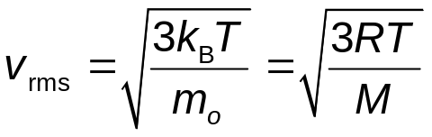

Root Mean Square Speed
The root mean square (rms) speed is the square root of the average of the squares of the speeds.
  Square, average, take the square root
Solving for v_{rms} we find
M is the molar mass and M = m_{o} N_{A}
Note about rms speed:
  The average is taken between the squaring and the square root steps.

Slide 12
Evaporation
The speed distribution for liquids is similar to that of gases.
Some molecules in the liquid are more energetic than others.
Some of the faster moving molecules penetrate the surface and leave the liquid.
  This occurs even before the boiling point is reached.
The molecules that escape are those that have enough energy to overcome the attractive forces of the molecules in the liquid phase.
The molecules left behind have lower kinetic energies.
Therefore, evaporation is a cooling process.

Slide 13
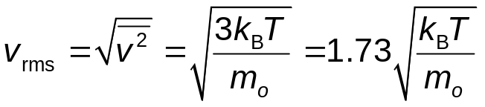
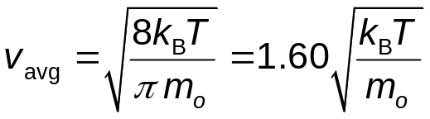
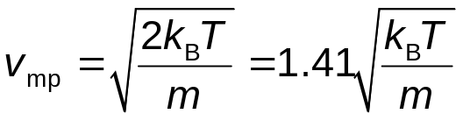
Speed Summary
Root mean square speed
The average speed is somewhat lower than the rms speed.
The most probable speed, v_{mp} is the speed at which the distribution curve reaches a peak.
v_{rms} > v_{avg} > v_{mp}

